Slide 1
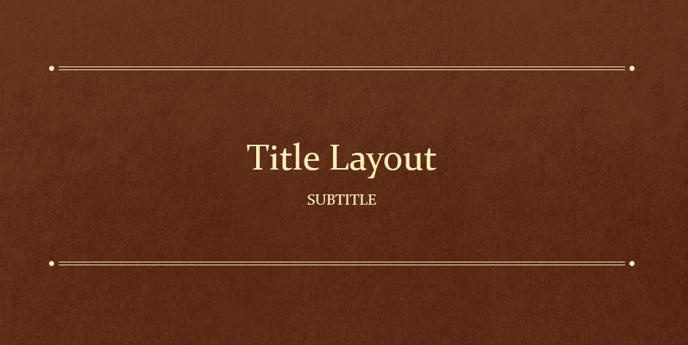

LE CERCLE DES SCRIBOUILLARDS volume 1

Slide 2
Le Cercle des Scribouillards
Comment les cours de génie logiciel nous ont-ils aidés à mener à bien le projet?

Slide 3
SOMMAIRE Chapitre 1 Lien entre la théorie et la pratique Chapitre 2 Présentation du projet Chapitre 3 Organisation et mise en place Chapitre 4 Démonstration Chapitre 5 Problème rencontrés, solutions trouvées Chapitre 6 Points perfectibles, restes à faire, points non solutionnés

Slide 4
CHAPITRE 1 : LIEN ENTRE THÉORIE ET PRATIQUE

Slide 5









Chapitre 1 : Lien entre la théorie et la pratique

Slide 6
CHAPITRE 2 : PRÉSENTATION DU PROJET

Slide 7

Chapitre 2 Présentation du projet
Inspiré de Reddit
Ecriture libre
Fonctionnalités
S’inscrire et se connecter
Proposer des thèmes et des articles
Consulter des thèmes et des articles
Voter pour un article

Slide 8
CHAPITRE 3 : ORGANISATION DU PROJET

Slide 9
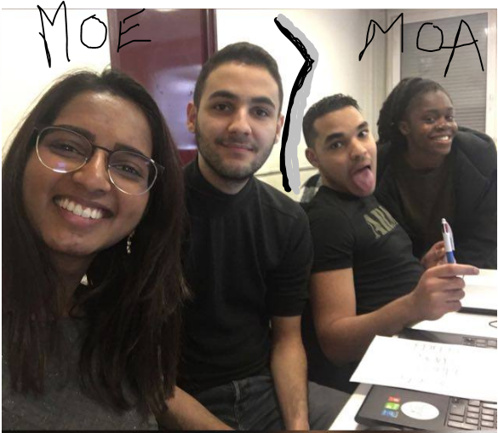


Chapitre 3 Organisation et mise en place (1/2)
Séparation de l’équipe en 2
Team meeting
Outils de communication

Slide 10
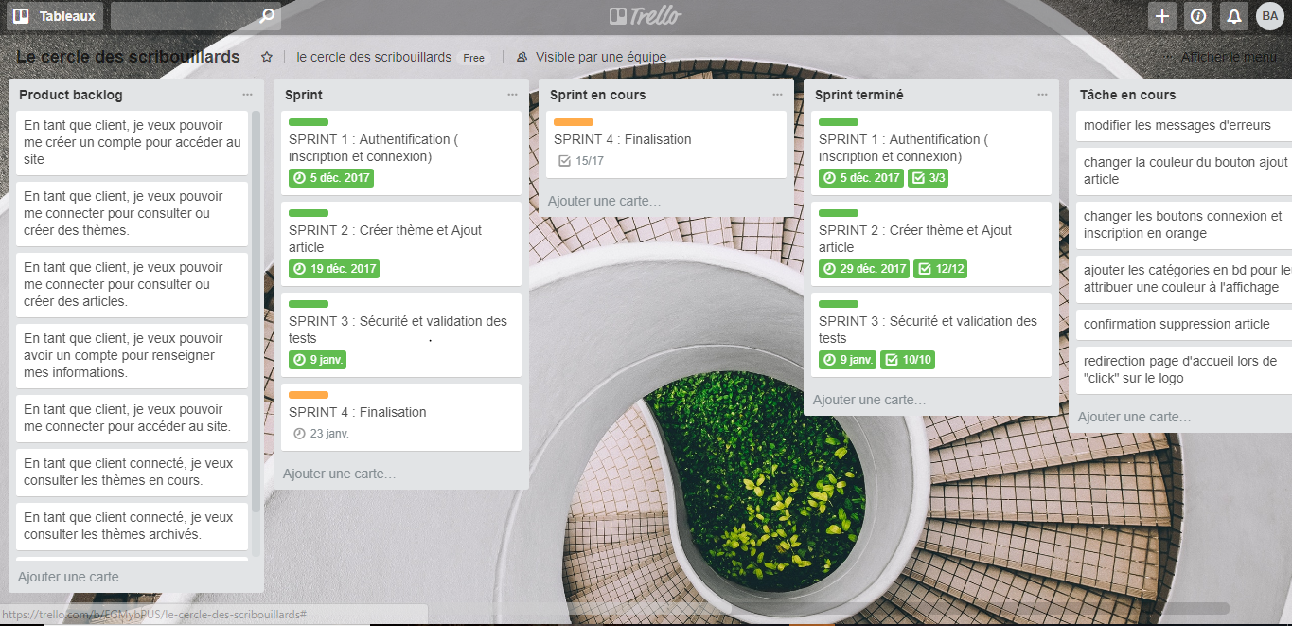
Chapitre 3 Organisation et mise en place (2/2)
Lien vers notre tableau de bords :
https://trello.com/b/EGMybPUS/le-cercle-des-scribouillards

Slide 11
CHAPITRE 4 : DÉMONSTRATION

Slide 12
CHAPITRE 5 : PROBLEMES RENCONTÉS SOLUTIONS TROUVÉES

Slide 13



Chapitre 4 Problème rencontrés
Mise en place de l’intégration continue
Mise en place des tests unitaires
Utilisation globale de Springboot.
Recherche d’une méthode de travail adaptée

Slide 14

Chapitre 4 Solutions trouvées
Utilisation du serveur SonarQube du professeur
Utilisation de la documentation
Division d’équipe
Maîtrise et mise en place de l’outil Trello
Recherche et tri sur les résultats

Slide 15
CHAPITRE 6 : AMÉLIORATIONS DU PROJET

Slide 16
Quotations are commonly printed as a means of inspiration and to invoke philosophical thoughts from the reader.

Slide 17
THIS IS A SLIDE TITLE
Here you have a list of items
And some text
But remember not to overload your slides with content
Your audience will listen to you or read the content, but won’t do both.

Slide 18
BIG CONCEPT
Bring the attention of your audience over a key concept using icons or illustrations

Slide 19
YOU CAN ALSO SPLIT YOUR CONTENT
White
Is the color of milk and fresh snow, the color produced by the combination of all the colors of the visible spectrum.
Black
Is the color of coal, ebony, and of outer space. It is the darkest color, the result of the absence of or complete absorption of light.

Slide 20
IN 2 OR 3 COLUMNS
Yellow
Is the color of gold, butter and ripe lemons. In the spectrum of visible light, yellow is found between green and orange.
Blue
Is the colour of the clear sky and the deep sea. It is located between violet and green on the optical spectrum.
Red
Is the color of blood, and because of this it has historically been associated with sacrifice, danger and courage.

Slide 21
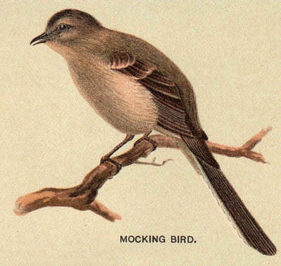
A PICTURE IS WORTH A THOUSAND WORDS
A complex idea can be conveyed with just a single still image, namely making it possible to absorb large amounts of data quickly.

Slide 22
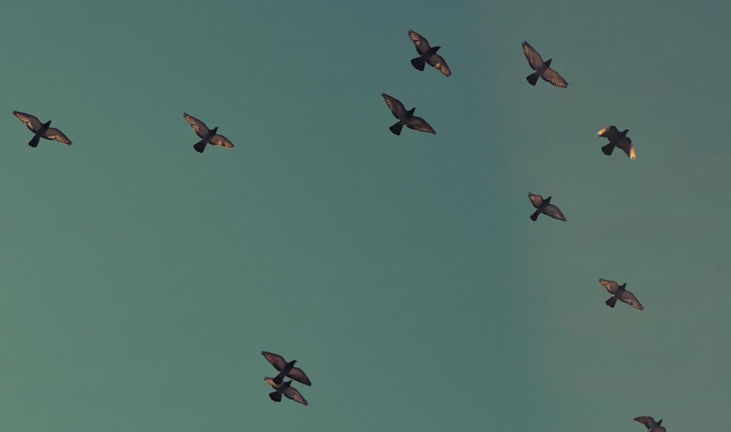
Want big impact?
USE BIG IMAGE

Slide 23
USE CHARTS TO EXPLAIN YOUR IDEAS
White
Gray
Black

Slide 24
AND TABLES TO COMPARE DATA
 | A | B | C
Yellow | 10 | 20 | 7
Blue | 30 | 15 | 10
Orange | 5 | 24 | 16

Slide 25
MAPS
our office

Slide 26
89,526,124
Whoa! That’s a big number, aren’t you proud?

Slide 27
89,526,124$
185,244 users
100%
That’s a lot of money
And a lot of users
Total success!

Slide 28
OUR PROCESS IS EASY
first
second
last

Slide 29
LET’S REVIEW SOME CONCEPTS
Yellow
Is the color of gold, butter and ripe lemons. In the spectrum of visible light, yellow is found between green and orange.
Blue
Is the colour of the clear sky and the deep sea. It is located between violet and green on the optical spectrum.
Red
Is the color of blood, and because of this it has historically been associated with sacrifice, danger and courage.
Yellow
Is the color of gold, butter and ripe lemons. In the spectrum of visible light, yellow is found between green and orange.
Blue
Is the colour of the clear sky and the deep sea. It is located between violet and green on the optical spectrum.
Red
Is the color of blood, and because of this it has historically been associated with sacrifice, danger and courage.

Slide 30
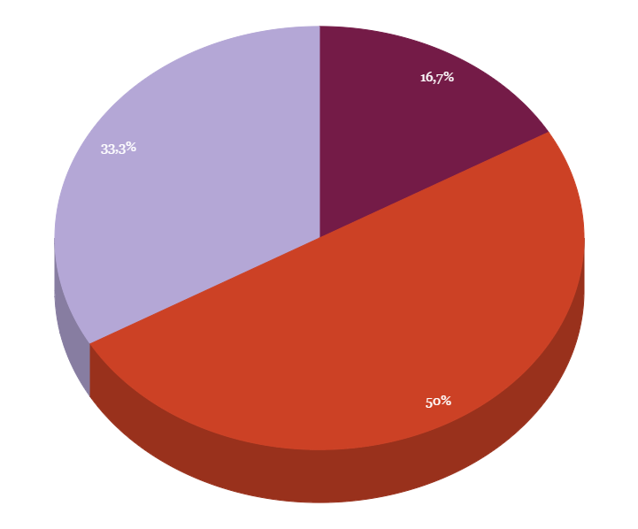
You can insert graphs from Google Sheets

Slide 31
ANDROID PROJECT
Show and explain your web, app or software projects using these gadget templates.
Place your screenshot here

Slide 32
iPHONE PROJECT
Show and explain your web, app or software projects using these gadget templates.
Place your screenshot here

Slide 33
TABLET PROJECT
Show and explain your web, app or software projects using these gadget templates.
Place your screenshot here

Slide 34
DESKTOP PROJECT
Show and explain your web, app or software projects using these gadget templates.
Place your screenshot here

Slide 35

THANKS!
Any questions?
You can find me at @username & user@mail.me

Slide 36
CREDITS
Special thanks to all the people who made and released these awesome resources for free:
Presentation template by SlidesCarnival
Photographs by Unsplash

Slide 37
PRESENTATION DESIGN
This presentation uses the following typographies and colors:
Titles: Oswald
Body copy: Tinos
You can download the fonts on this pages:
https://www.fontsquirrel.com/fonts/oswald · https://www.fontsquirrel.com/fonts/tinos
You don’t need to keep this slide in your presentation. It’s only here to serve you as a design guide if you need to create new slides or download the fonts to edit the presentation in PowerPoint®

Slide 38
SlidesCarnival icons are editable shapes.
This means that you can:
Resize them without losing quality.
Change fill color and opacity.
Isn’t that nice? :)
Examples:

Slide 39
😉
Now you can use any emoji as an icon!
And of course it resizes without losing quality and you can change the color.
How? Follow Google instructions https://twitter.com/googledocs/status/730087240156643328
✋👆👉👍👤👦👧👨👩👪💃🏃💑❤😂😉😋😒😭👶😸🐟🍒🍔💣📌📖🔨🎃🎈🎨🏈🏰🌏🔌🔑 and many more...

